Slide 1
Strike! Proposal
(working title)
By Isaiah Hull

Slide 2
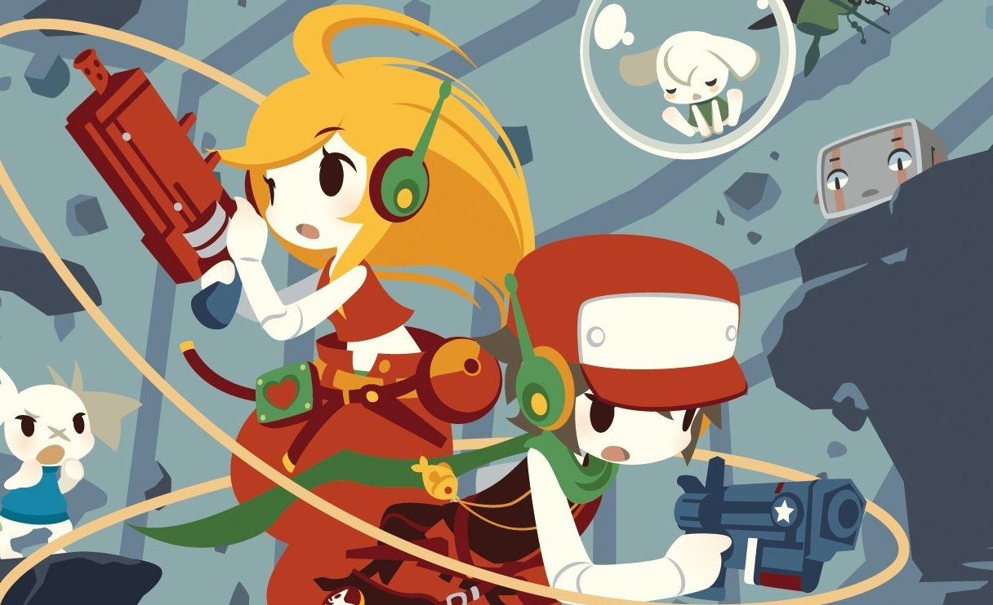
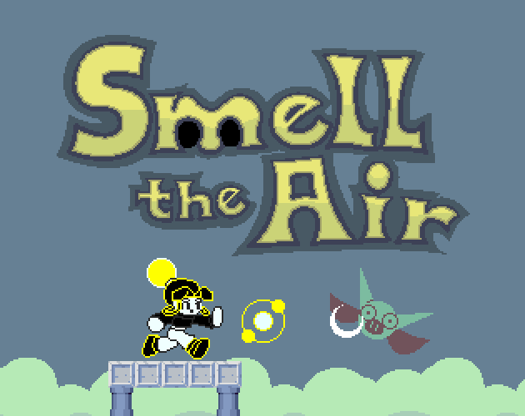
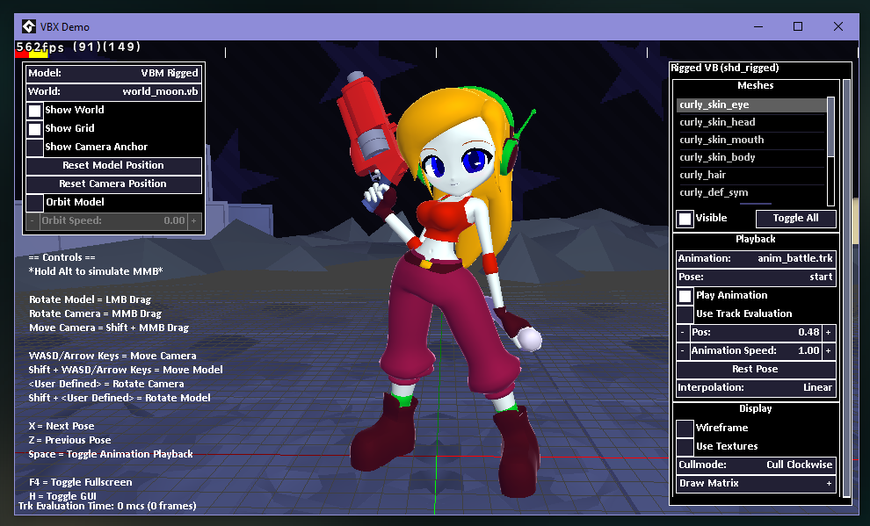
About me
I like Cave Story
Messed with Game Development for 6+ years
Programming is strongest skill
Winter Break Project: Blender Model Exporter to GMS2
Hunter
Notes:
If I were to sum up my person in one phrase it would be: “If I like something, I try to make it myself.”

Slide 3
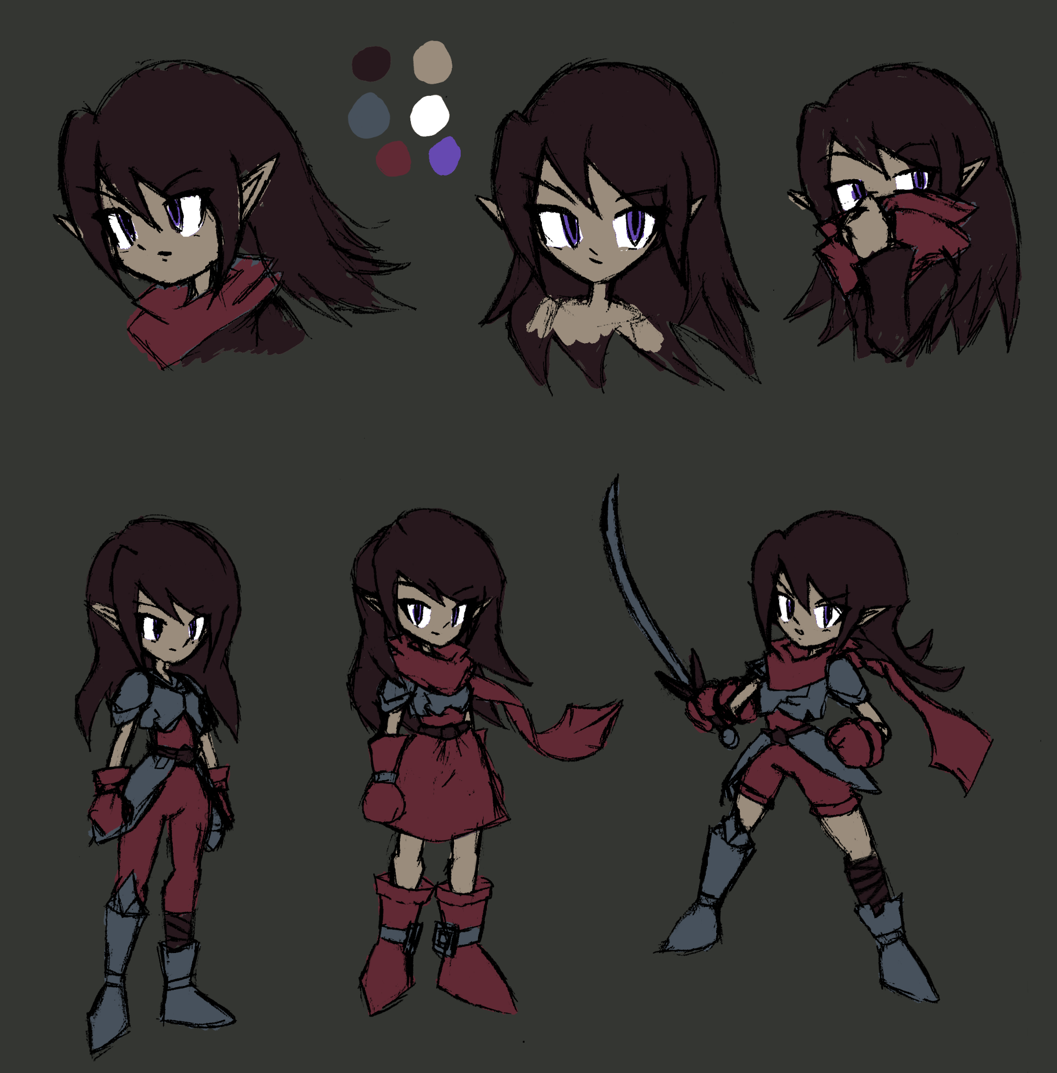
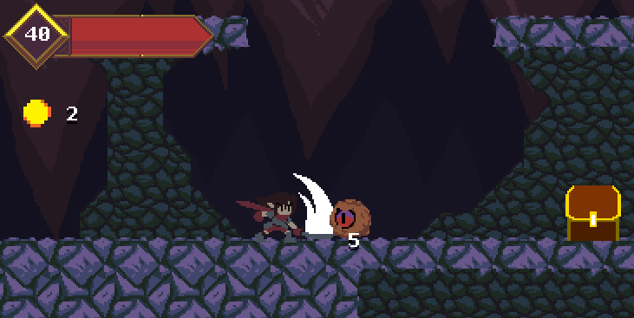
Hunter
Semester project for Game Dev Club
Hack-n-slash platformer
Team of 6 people
My roles were programming and art
My first project on a team

Slide 4
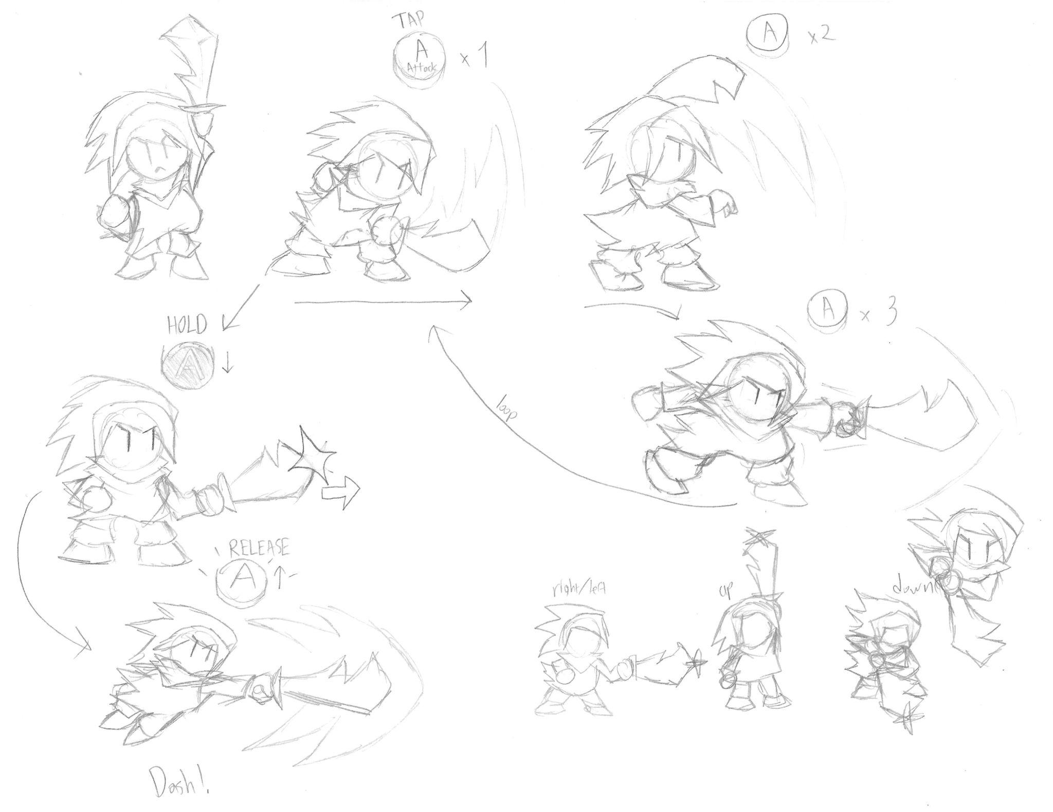
Strike!!
Scrapped idea for Hunter
Player slashes by mashing Attack button
If player holds and releases, they dash
Dash direction is based on initial slash

Slide 6
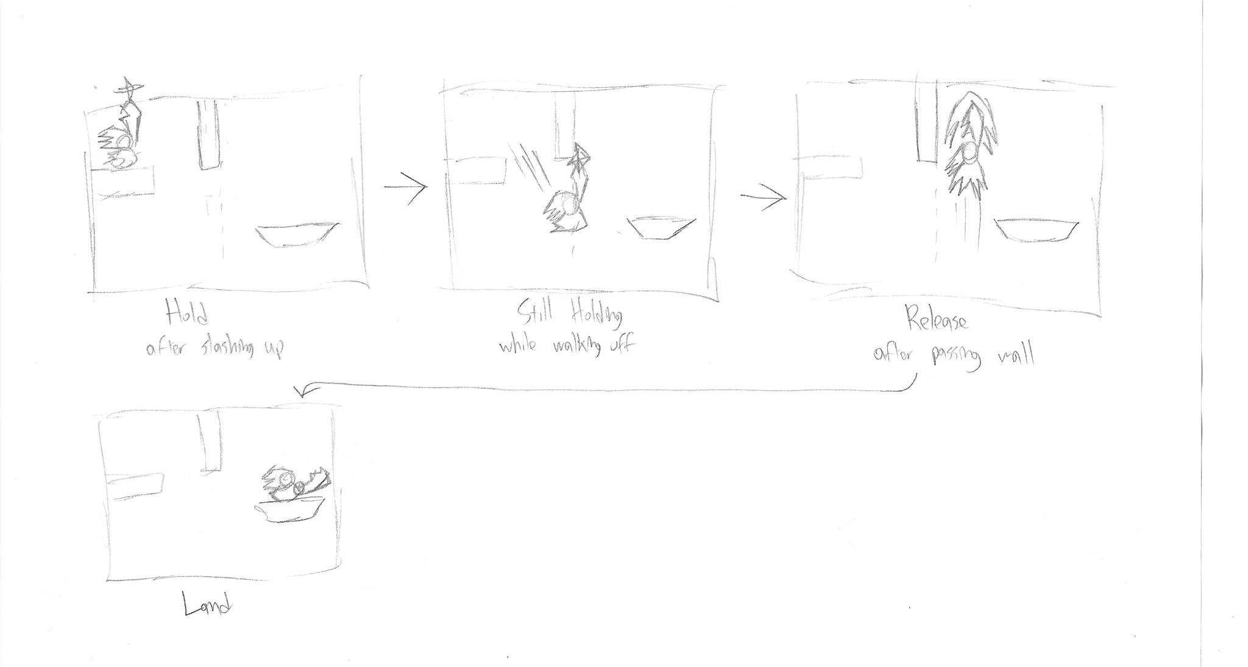
Strike!!! Example
Player holds up and attacks, keeping the button held down
Player walks off platform, still holding the button
Player releases button after passing the wall
Win EVO
Notes:
Focus on platforming, not too much on combat
Levels have some parkour puzzle elements

Slide 8
Why Strike!!!!?
Simple main mechanic = Easy Foundation
Good avenue to learn basic things about a new engine (like I may have to do)
Level design practice
Mostly movement-based
Ideas for character expression
Notes:
Rebound off of walls for speed?

Slide 9
That’s all
Thanks for your time
Notes:
I’ll be around.

